Slide 1
Basic Mechanics & Robot Design
Ultimate Programming Dragons

Slide 2

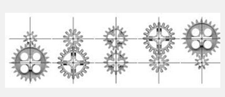
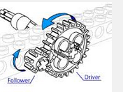
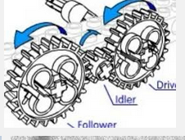
Gear Box (rotation-rotation)

Slide 3
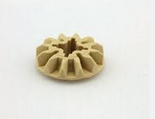
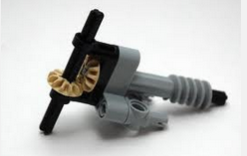
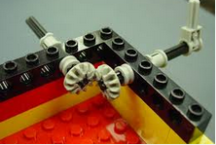
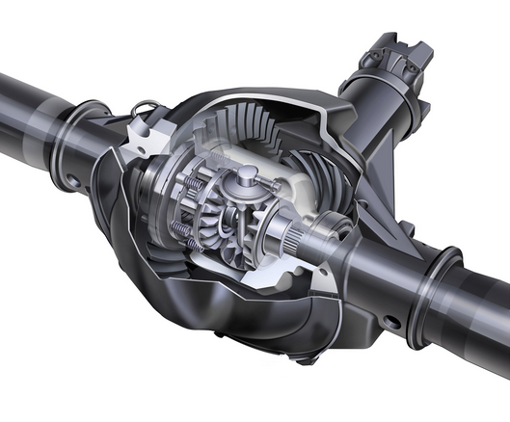
Bevel Gears (Change Pivot Direction)

Slide 4
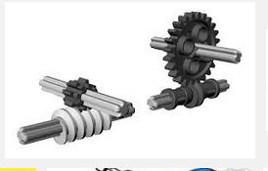
Worm gear (one-way drive)

Slide 5
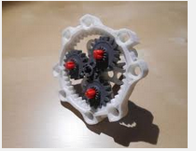
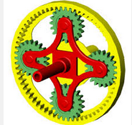
Planet Gear (Change ratios & direction)

Slide 6
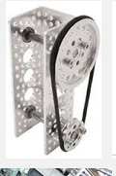
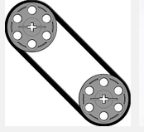
Belt & Chain (rotation to translation)

Slide 7
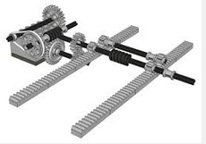
Rack-Pin (rotation to translation)

Slide 8
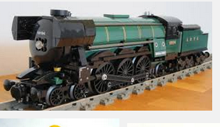
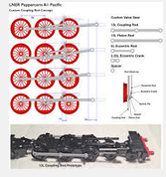
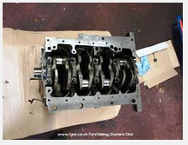
Crank-Rod (rotation to oscillation)

Slide 9
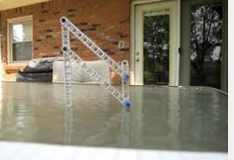
Four Bar Linkage

Slide 10
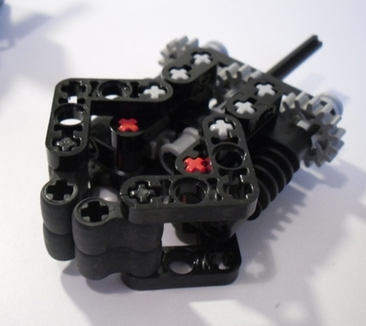
Grab Claw

Slide 11
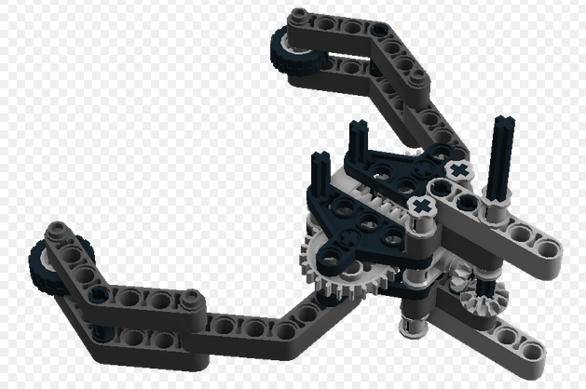
Grab Claw

Slide 12
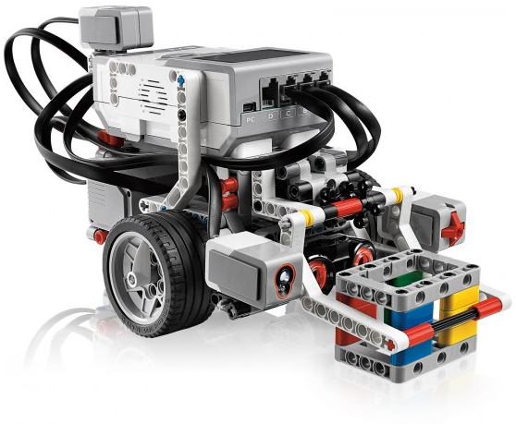
Smallest with Big Wheel

Slide 13
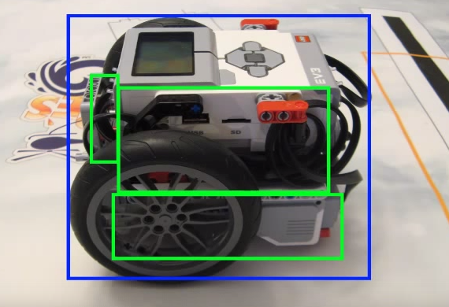
Rectangle with big wheels(Builderdude35)

Slide 14
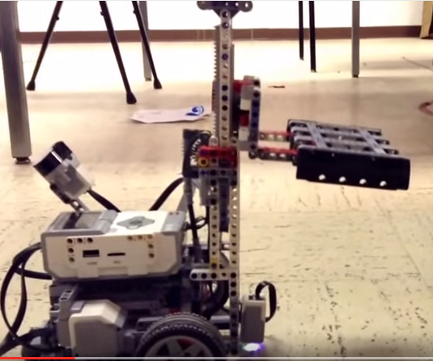
Fork Lift (GOISD Programming)

Slide 15
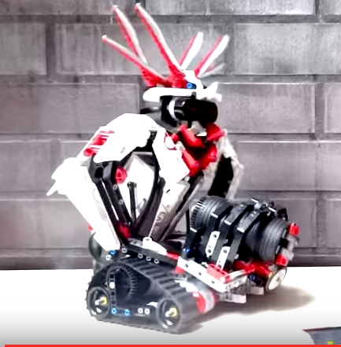
GRIPP3R (RoboticLife)

Slide 16
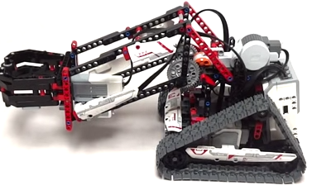
Gripper & Lifter (RoboticLife)

Slide 17
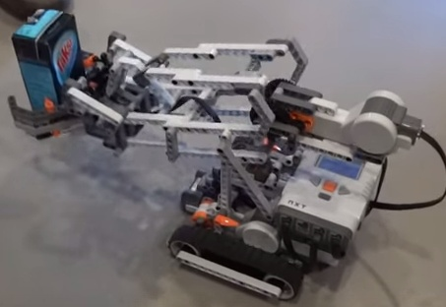
Grab and lift (Laurens Valk)

Slide 18
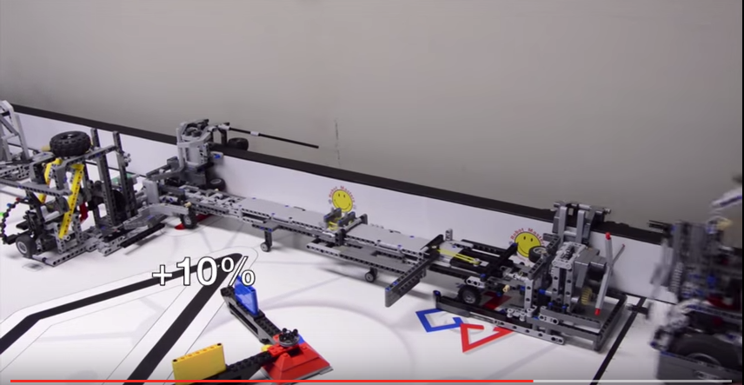
Complex Attachment (robot masters 857)

Slide 19
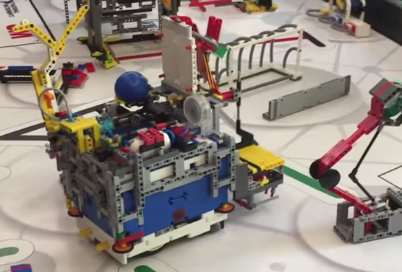
2015 TARDIS (826)

Slide 20
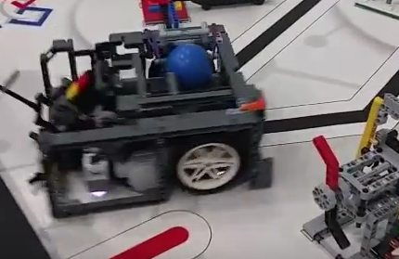
2015 NEO (708)

Slide 21
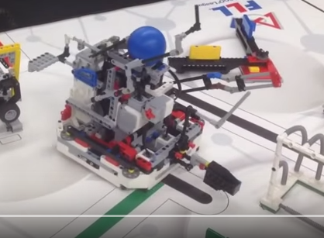
2015 R-Cubed (542)

Slide 22
Tips for robot design
Make it small as possible
Make it square
Use bigger wheels
Put wheels close as possible
Tighten all wires
Use appropriate steering wheel
Color sensor close to ground or shield ambient light
Place color/gyro sensor in the middle
Easy to switch attachments
Use side slide roller to avoid stuck

